Slide 1
Recap lecture 31
Context Free Grammar, Terminals, non-terminals, productions, CFG, context Free language, examples.

Slide 2
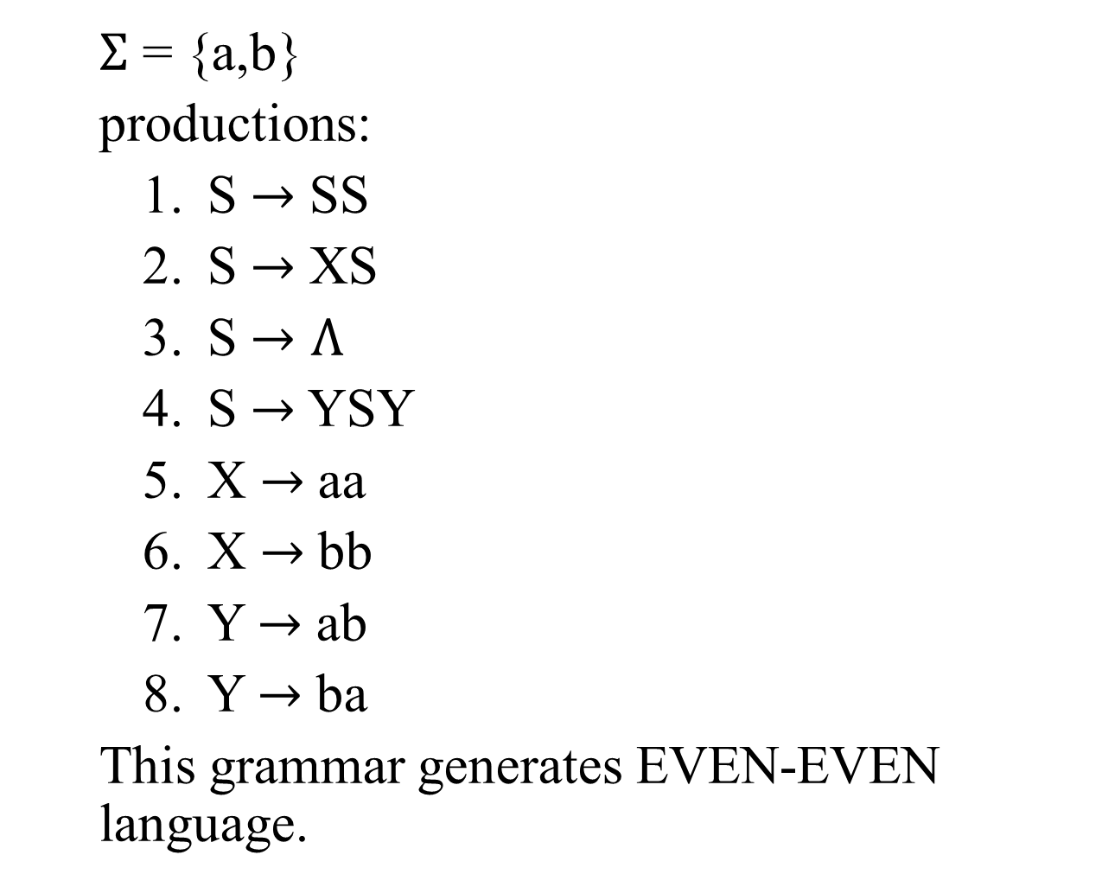
Example
$Σ$ = {a,b}
productions:
S $→$ SS
S $→$ XS
S $→Λ$
S $→$ YSY
X $→$ aa
X $→$ bb
Y $→$ ab
Y $→$ ba
This grammar generates EVEN-EVEN language.

Slide 3
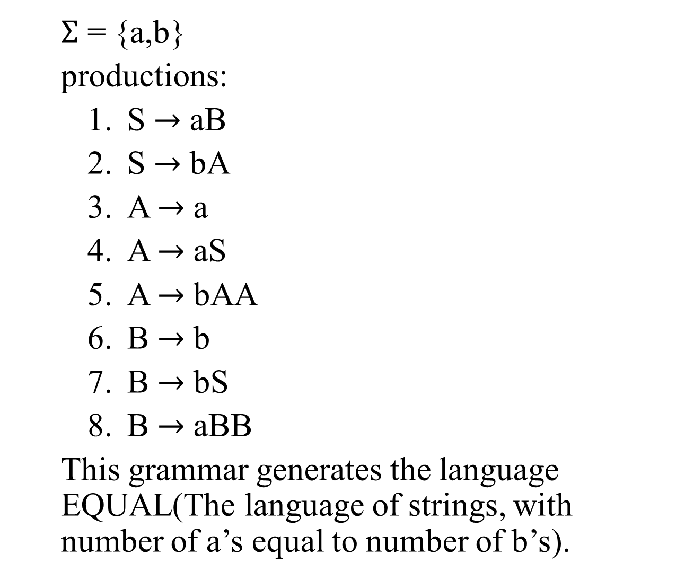
Example
$Σ$ = {a,b}
productions:
S $→$ aB
S $→$ bA
A $→$ a
A $→$ aS
A $→$ bAA
B $→$ b
B $→$ bS
B $→$ aBB
This grammar generates the language EQUAL(The language of strings, with number of a’s equal to number of b’s).

Slide 4
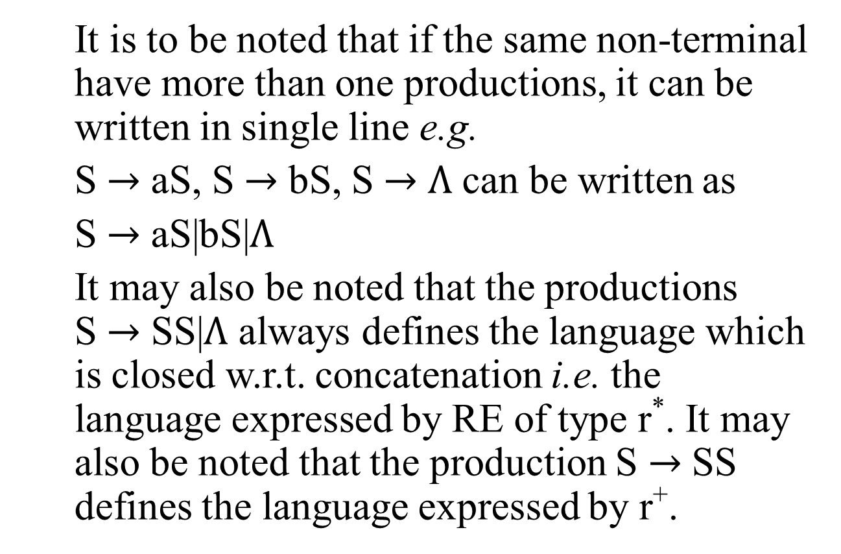
Note
It is to be noted that if the same non-terminal have more than one productions, it can be written in single line e.g.
S $→$ aS, S $→$ bS, S $→$ $Λ$ can be written as
S $→$ aS|bS|$Λ$
It may also be noted that the productions S $→$ SS|$Λ$ always defines the language which is closed w.r.t. concatenation i.e. the language expressed by RE of type r*. It may also be noted that the production S $→$ SS defines the language expressed by r⁺.

Slide 5
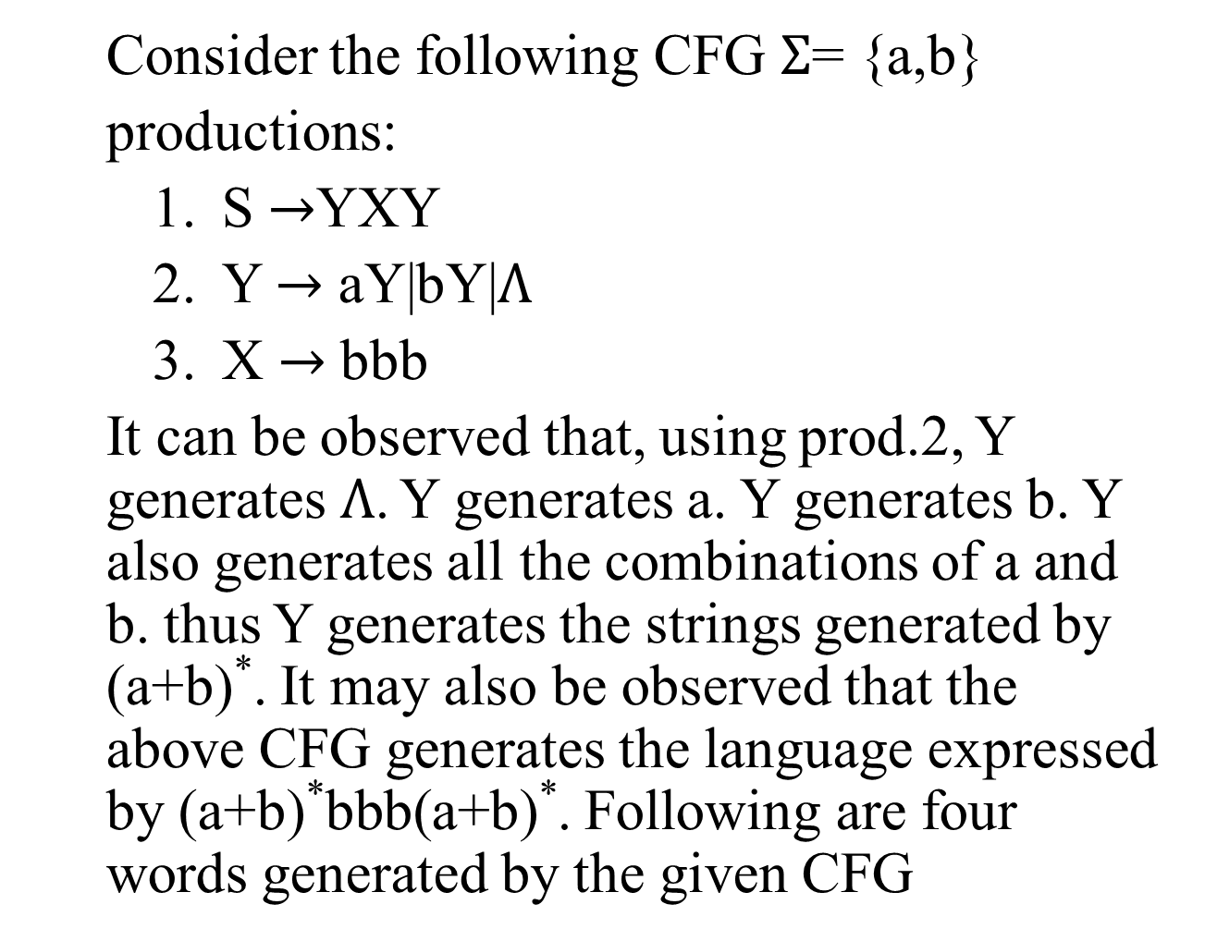
Example
Consider the following CFG $Σ$= {a,b}
productions:
S $→$YXY
Y $→$ aY|bY|$Λ$
X $→$ bbb
It can be observed that, using prod.2, Y generates$Λ$. Y generates a. Y generates b. Y also generates all the combinations of a and b. thus Y generates the strings generated by (a+b)*. It may also be observed that the above CFG generates the language expressed by (a+b)*bbb(a+b)*. Following are four words generated by the given CFG

Slide 6
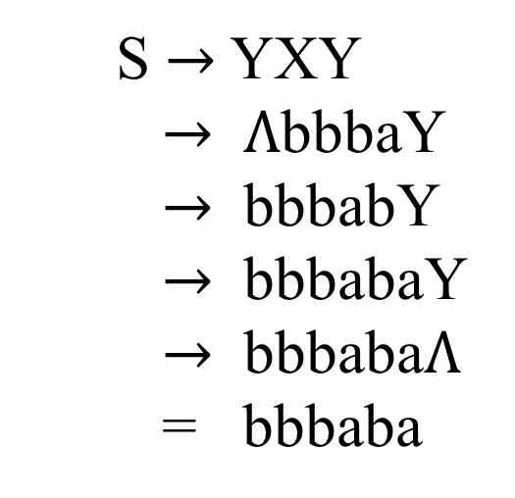
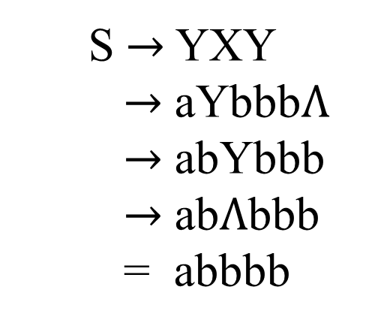
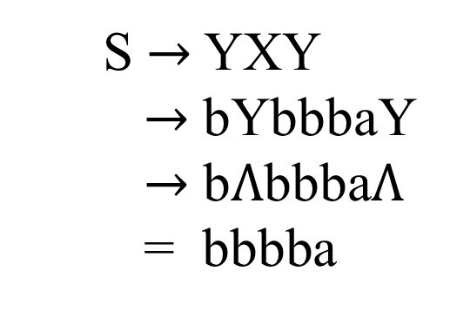
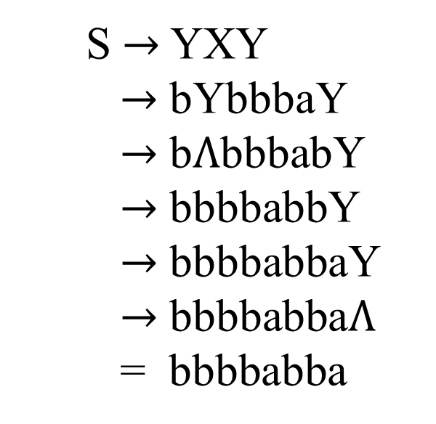
Example continued …
S $→$ YXY
$→$ aYbbb$Λ$
$→$ abYbbb
$→$ ab$Λ$bbb
= abbbb
S $→$ YXY
$→$ bYbbbaY
$→$ b$Λ$bbbabY
$→$ bbbbabbY
$→$ bbbbabbaY
$→$ bbbbabba$Λ$
= bbbbabba
S $→$ YXY
$→$ $Λ$bbbaY
$→$ bbbabY
$→$ bbbabaY
$→$ bbbaba$Λ$
= bbbaba
S $→$ YXY
$→$ bYbbbaY
$→$ b$Λ$bbba$Λ$
= bbbba

Slide 7
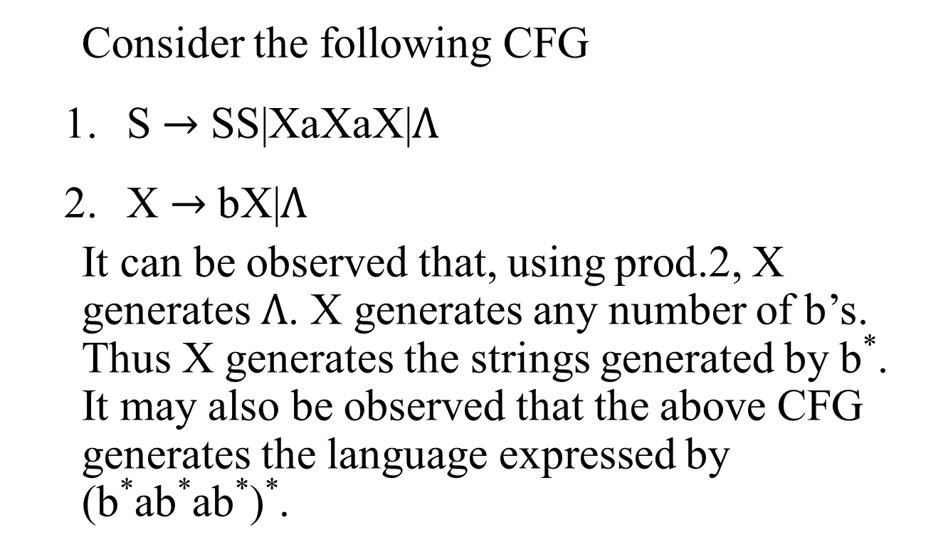
Example
Consider the following CFG
S $→$ SS|XaXaX|$Λ$
X $→$ bX|$Λ$
It can be observed that, using prod.2, X generates $Λ$. X generates any number of b’s. Thus X generates the strings generated by b*. It may also be observed that the above CFG generates the language expressed by (b*ab*ab*)*.

Slide 8
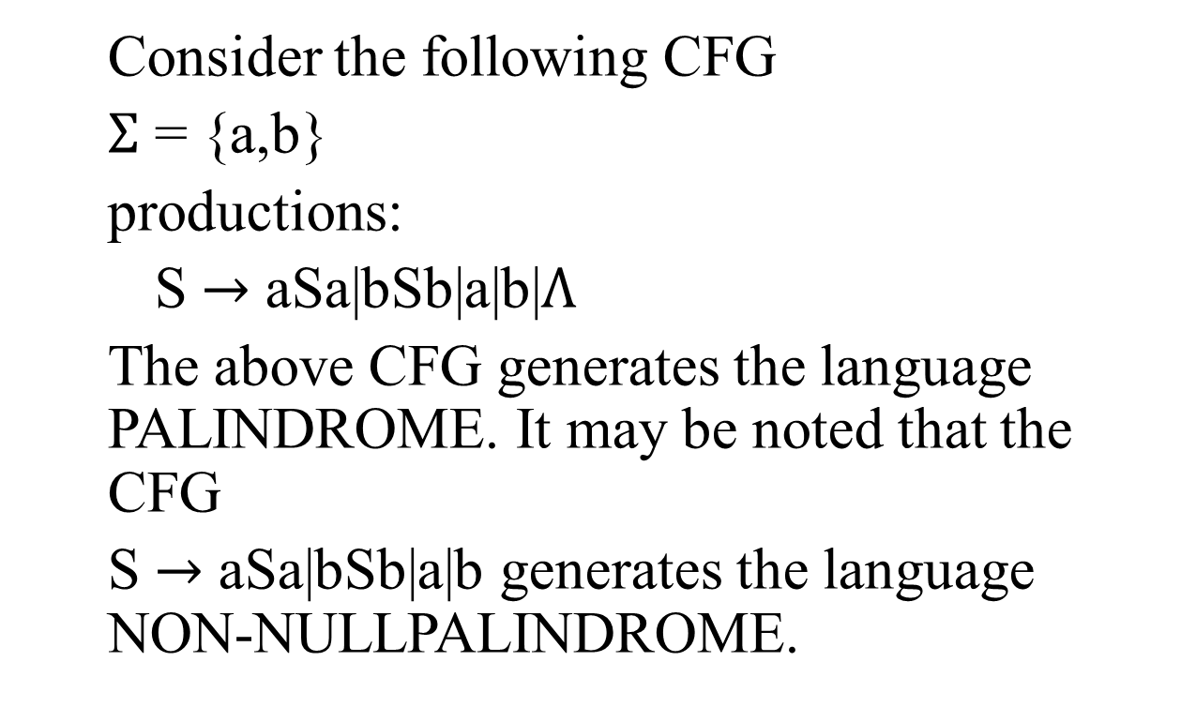
Example
Consider the following CFG
$Σ$ = {a,b}
productions:
S $→$ aSa|bSb|a|b|$Λ$
The above CFG generates the language PALINDROME. It may be noted that the CFG
S $→$ aSa|bSb|a|b generates the language NON-NULLPALINDROME.

Slide 9
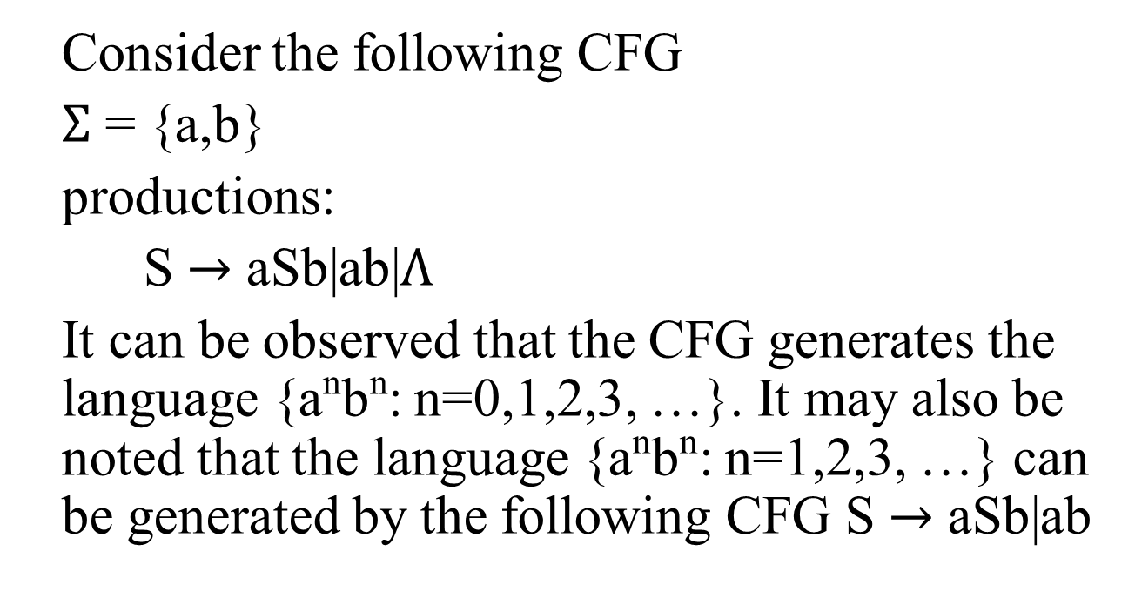
Example
Consider the following CFG
$Σ$ = {a,b}
productions:
S $→$ aSb|ab|$Λ$
It can be observed that the CFG generates the language {a^{n}b^{n}: n=0,1,2,3, …}. It may also be noted that the language {a^{n}b^{n}: n=1,2,3, …} can be generated by the following CFG S $→$ aSb|ab

Slide 10

Task
Construct CFG that generates the language L = {w $∈${a,b}*: length(w) $≥$ 2 and second letter of w from right is a}

Slide 11
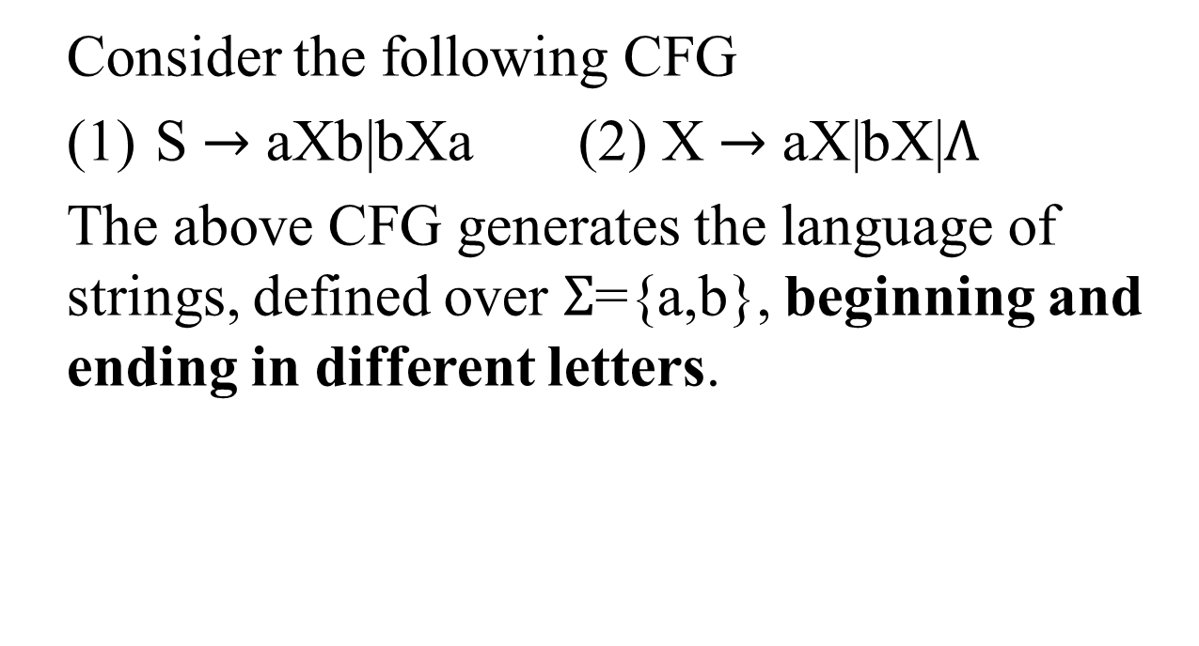
Example
Consider the following CFG
(1) S $→$ aXb|bXa (2) X $→$ aX|bX|$Λ$
The above CFG generates the language of strings, defined over $Σ$={a,b}, beginning and ending in different letters.

Slide 12

Task
Construct the CFG for the language of strings, defined over $Σ$={a,b}, beginning and ending in same letters.

Slide 13
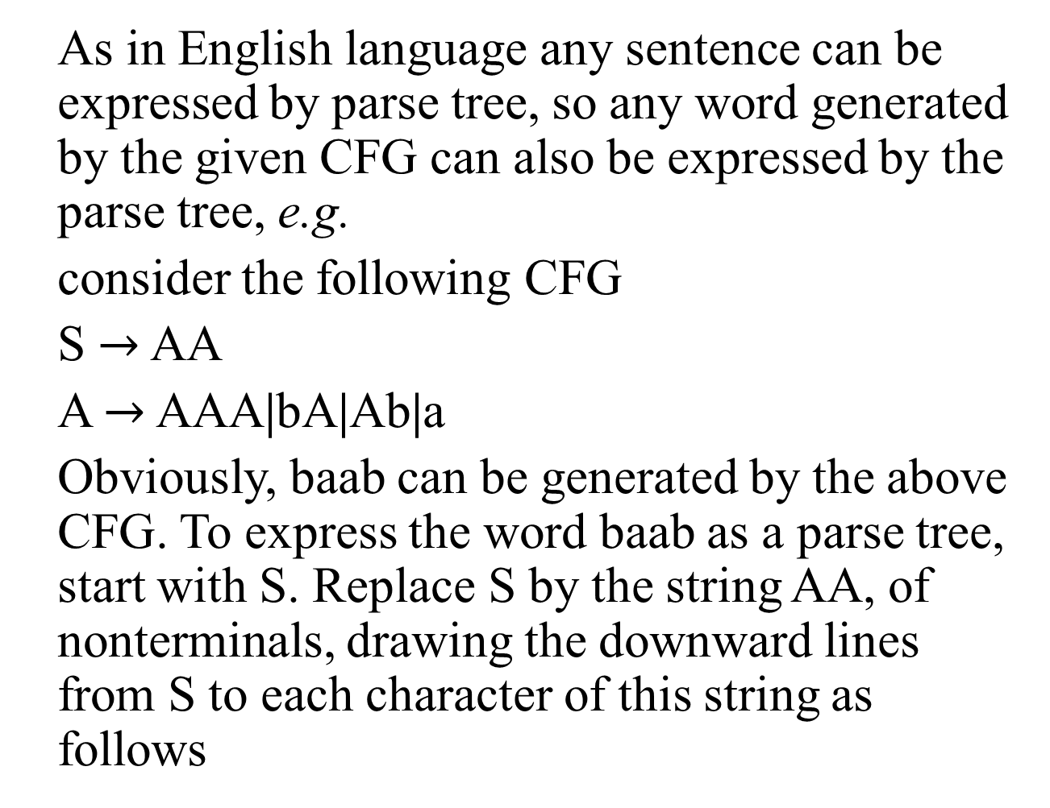
Trees
As in English language any sentence can be expressed by parse tree, so any word generated by the given CFG can also be expressed by the parse tree, e.g.
consider the following CFG
S $→$ AA
A $→$ AAA|bA|Ab|a
Obviously, baab can be generated by the above CFG. To express the word baab as a parse tree, start with S. Replace S by the string AA, of nonterminals, drawing the downward lines from S to each character of this string as follows

Slide 14
Trees continued …
S
Now let the left A be replaced by bA and the right one by Ab then the tree will be
A
A
S
A
A
b
A
b
A

Slide 15
Trees continued …
Replacing both A’s by a, the above tree will be
S
A
A
b
A
b
A
a
a

Slide 16
Trees continued …
Thus the word baab is generated. The above tree to generate the word baab is called Syntax tree or Generation tree or Derivation tree as well.

